Slide 1








Presentation on-
Controlling a UAV using remote framebuffer protocol
Presenter-
Shakur Mahmood
ID: 22-92338-1
Department: MSCS
American International University - Bangladesh

Slide 2
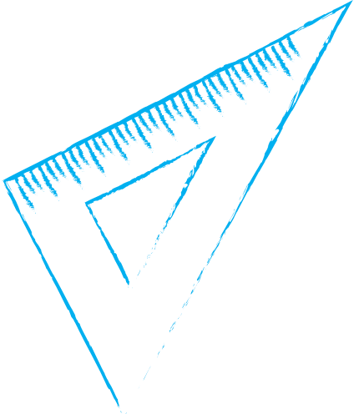

CONTENTS
1
2
3
4
5
6
Literature Review
Proposed System Based on
RFB Protocol
Field Experiment
Introduction
Discussion
Conclusion

Slide 3





1
Introduction

Slide 4

Introduction
Drone technologies are getting more attention to the researchers due to it’s growing popularity. It is an easier and efficient way to explore the remote areas of the world.
FPV (First Person View) drones are most commonly used where one person views the world through a camera fitted onto the drone, and use that ‘first person’ perspective to fly the drone. Here, the system is limited to one person’s view only.
If we can control a drone using client-server protocol, it enlarges our scope and widens the area to control it. This research will show the possibility of creating such drone using Remote Framebuffer (RFB) protocol and will discuss the comparative analysis with the other existing methods to control a UAV (Unmanned Arial Vehicle).
In this case,as the system will use a client-server based model and this thesis wants to control a UAV from anywhere in the world, so using 4g/5g internet (internet provided by the cell phone towers) will be an efficient and cost effective way of communication with the UAV than other alternatives, such as, the satellite internet or the balloon mesh network.

Slide 5
2
Literature review

Slide 6
Literature review
An UAV system has two parts, the drone itself and the control station at ground which is called ground control systems (GSC).
Making a drone is expensive. That is why researchers are not eager to do research on this topic.
Moreover, there are a lot of chances of chrashing if somehow connection is lost or any part does not function properly.
In that case, the total cost does not bring appropriate results to the researchers.
But still there are some good researches as well. Such as, Wzorek et al., 2006, used gprs technology using gsm network to control a helicopter. It was an expensive research.

Slide 7
Literature Review
Mozaffari et al., 2017, discussed how UAVs as base station can enable IoT devices to communicate energy efficiently.
Fouda et al., 2018, discussed a technique to improve 5g communications using UAVs as base stations.
Zeng et al., 2018, discussed the advantages of cellular connection in a UAV and basic structure of this communication.
Eular et al., 2019, discussed the mobility support for cellular connected UAVs.They evaluated their work using simulation technique.
Guang et al., 2018, Built a prototype using data acquisition module, a flight control device, and a data processing server. However, they did not discuss the total UAV structure and the equipment’s using purposes.

Slide 8
Literature Review
All this research works created a research gap which was ‘not reducing the complexity of a UAV structure’and that has motivated this thesis work.
Controlling a UAV using client-server based model or controlling through cell phone towers are not new ideas but controlling a uav using remote framebuffer (RFB) protocol is completely a new idea.
Using this protocol a user gets full satisfaction of controlling a UAV and even worldwide if the user can connect the UAV to the internet.
Before discussing the model that presents how to control a UAV using RFB protocol, it is needed to discuss how RFB protocol and a UAV work.

Slide 9
2.1
How RFB protocol works

Slide 10
How RFB protocol works
RFB (Remote FrameBuffer) protocol is used in Virtual Network Computing (VNC) and its derivatives. It is an open simple protocol for remote access to graphical user interfaces (GUI).
As it works at the framebuffer level it is applicable to all windowing systems and applications, including Microsoft Windows, macOS, Linux, Raspbian OS etc.
RFB protocol is a client-server based protocol and VNC is platform-independent. So, multiple clients may connect to a VNC server using RBF protocol at the same time.
Currently, all VNC implementations consist of two pieces of software: a VNC server and a VNC viewer (client).
VNC Server
RFB protocol through Ethernet or WAN
VNC Viewer
CPU, DRAM Main Memory, Partial GPU, FB, Network I/F
Partial GPU, FB, Network I/F
Monitor
Host Platform
Keyboard, Mouse
User Device
Figure: VNC and Remote-Desktop belong to the FB approach.

Slide 11
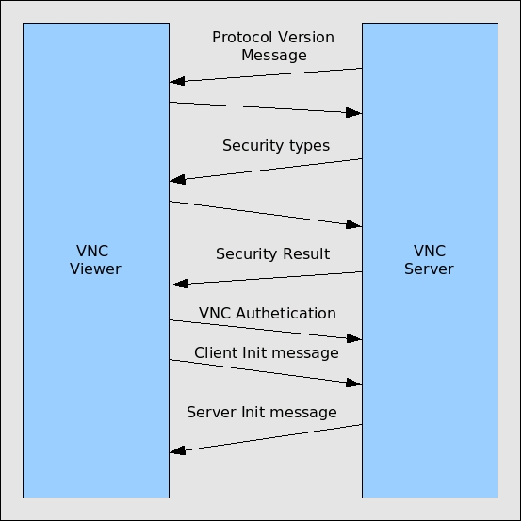
How RFB protocol works
Figure: How RFB protocol works in VNC.
There are three stages to the protocol. First is the handshaking phase, the purpose of which is to agree upon the protocol version and the type of security to be used.
The second stage is an initialisation phase where the client and server exchange ClientInit and ServerInit messages.
The final stage is the normal protocol interaction. The client can send whichever messages it wants, and may receive messages from the server as a result.

Slide 12
2.2
How a UAV works

Slide 13
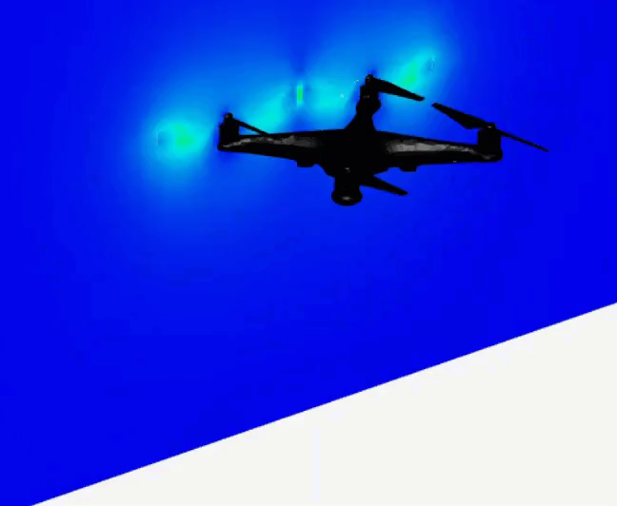
Lift
How a UAV works
A=High
B=Low
Drag
Thrust
D=High
C=Low
Weight
Moving Direction
Figure: Four forces occur in UAVs.
Drone aerodynamics plays a crucial role in the efficient and stable flight of UAVs.
Understanding the principles of lift, thrust, drag, and weight are fundamental to designing and operating drones.

Slide 14
2.3
How a quadcopter moves

Slide 15
How a quadcopter moves
A=High
and
Equal
B=High
and
Equal
A=Low
and
Equal
B=Low
and
Equal
A=High
A=Low
B=High
B=Low
D=High
and
Equal
C=High
and
Equal
D=Low
and
Equal
C=Low
and
Equal
D=Low
C=High
D=High
C=Low
(a) Up
(b) Down
(c) Right Yaw
(d) Left Yaw
A=Low
B=Low
A=High
B=High
A=Low
B=High
A=High
B=Low
D=High
C=High
D=Low
C=Low
D=Low
C=High
D=High
C=Low
(e) Forward
(f) Backward
(g) Left
(h) Right
Figure: Basic operations of a quadcopter drone.

Slide 16
2.4
Problem statement

Slide 17
Problem statement
To formulate the problem, lets assume a user has 2 UAVs of same model, made by the same manufacturer and the receivers in both the UAVs have a lot of channels.
If two receivers having the same number of required channels and they are bound with one radio transmitter then both aircraft would experience the same control commands simultaneously from that transmitter.
It may cause unwanted collision with other objects. This is why it is illegal to fly or observe more than 1 aircraft by 1 operator simultaneously in the USA.
Another problem is using traditional TX protocols to establish a communication between a radio transmitter and a radio receiver has a range limit.
The transmitter that comes with consumer drones usually works on 2.4 GHz frequency and has a maximum range of 1.6 km.

Slide 18
Problem statement
There are lots of protocols that uses the client-server model. The protocols those are needed to mention for this thesis are live streaming protocols because one of the major reason for using UAVs by the users is to explore the world from above. So, here video streaming is needed.
And users will use client-server model in a UAV mainly to explore the places those are far away from them. But live streaming protocols are slower. It takes 5-20 seconds to reach to the clients.
It is because once the stream which is received from the server to a Video Distribution Service (VDS), is assigned to process it. It adds delivery method, security features, scalability and compatability. For example, HLS (HTTP Live Streaming) protocol delivers video segments in small chunks, which makes it scalable and compatible with most devices, but also introduces a latency of 5-20 seconds.
In addition, multiple bitrates are output. So for the incoming stream, there is need to make multiple renditions so that viewers with varying internet speeds can watch the video without buffering or lagging.
On the other hand, RFB protocol is optimized for low latency and high performance. It has provided a lot faster streaming during this thesis work.

Slide 19
3
Proposed system
based on RFB protocol

Slide 20
Proposed system
PC with internet connection
UAV with an internet modem
Figure 3.2(iii): Controlling a UAV using client-server model through the cell phone towers.
The proposed model of this thesis is very simple. This thesis wants to control a UAV using internet provided by the cell phone towers. So, it is needed to attach internet modem to the drone.
And it is needed to use a device that supports internet modem as well as RFB protocol, more specifically, VNC system (virtual network computing) which uses the RFB protocol to remotely control another device. And pyhton code will be used to control the motors. In all combination, this thesis uses raspberry pi inside the UAV which supports all the above tools and it is lightweight as well.
As a ground station we can use any device that supports VNC system with internet connection from anywhere in the world.

Slide 21
3.1
Mathmatical formulas

Slide 22

Mathmatical formulas
There are a lot of mathmatical formulas regarding a UAV. But here will be discussed the most important formulas those are used to fly a UAV.
Propeller power, P is calculated from the measured propeller torque, Q by-
P = 2πnQ ............ (i)
Here, n is the rotational speed of the propeller in revolutions per second (rps).
Aerodynamic power, P_{aero} is computed as-
............ (ii)
Here, f is the thrust produced, ρ is the density of the air, and A_{p} is the area swept by the rotor.

Slide 23
Mathmatical formulas
Power of a lipo battery, P is measured by the following formula-
P = VI ................. (iii)
The voltage influences the power of the battery, and power has an impact on the RPM (Rotations Per Minute) of the motor, which means speed.
The behaviour of air depends on temperature, pressure, and density related to each other. It can be described by the Ideal or Perfect Gas Equation of State:
P = ρRT .............. (iv)
Another equation that is used in aircraft is -
Power = (Thrust)(Velocity) ............. (v)
Performance of the aircraft is measured in power. Power and thrust are two different things but they are directly related to each other through speed.

Slide 24
3.2
Algorithm

Slide 25
Algorithm
Algorithm: Spinning the BLDC motors.
Functions: ‘Down’, ‘Up’, ‘Forward’, ‘Left’, ‘Backward’, ‘Right’, ‘Right_yaw_motion’, ‘Left_yaw_motion’, ‘Landing’.
While input is True within a time period-
Camera On
Call The function according to the input.
if unable to Call any function then
Exit Loop.
Landing the UAV
stop GPIO PWM functions
cleanup GPIO Ports
Camera Off

Slide 26
3.3
Flowchart

Slide 27
Start :
Camera
Flowchart
Start/Reset Timing :
To Exit the System
Do :
According to the User Input
Start
After a Given Time Period
User Input
True but not ‘esc’ key
False
Input equals to :
‘F’/‘G’/‘H’/‘I’/‘J’/‘K’/‘L’/‘M’/‘N’/‘esc’ key
Landing
Stop :
GPIO PWM functions
True and ‘esc’ key
On
Reset :
GPIO ports
Camera :
On/Off
On
Exit :
Camera
Start/Reset Timing :
On/Off
Off
Exit :
The System
Off
Flowchart: Workflow of the total system.

Slide 28
3.4
Circuit diagram

Slide 29
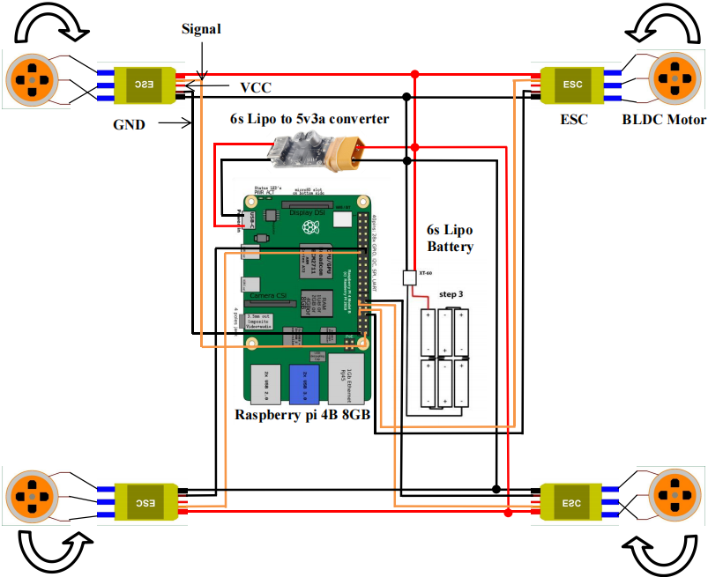
Circuit diagram
Diagram: Circuit Diagram of the total system.

Slide 30
Circuit diagram
Table: Lipo batteries voltage information
(a) For 6s Lipo battery.
(b) For 7s Lipo battery.
Topic | Information
Nominal Battery Voltage | 22.2V
Maximum Battery Voltage | 25.2V
Minimum Battery Voltage | 18.6V
Topic | Information
Nominal Battery Voltage | 25.9V
Maximum Battery Voltage | 29.4V
Minimum Battery Voltage | 21.7V

Slide 31
4
Field experiment

Slide 32
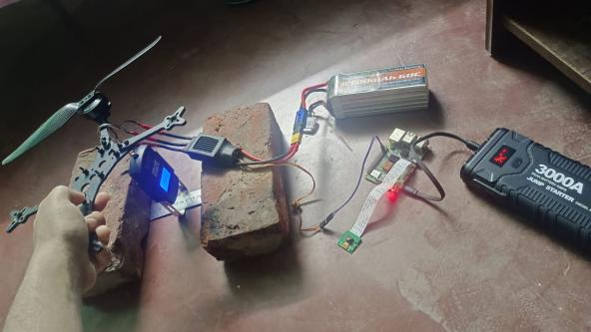
Field experiment
Table: System weight and thrust produced by the propeller.
Equipment | Information
Total system’s weight (without battery) | 1300 grams.
Battery weight | 850 grams.
Maximum thrust given by each 10 inches propeller | 700 grams.
Figure: Thrust test.

Slide 33
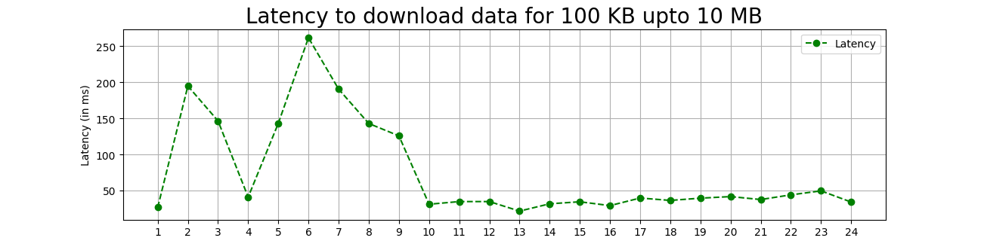
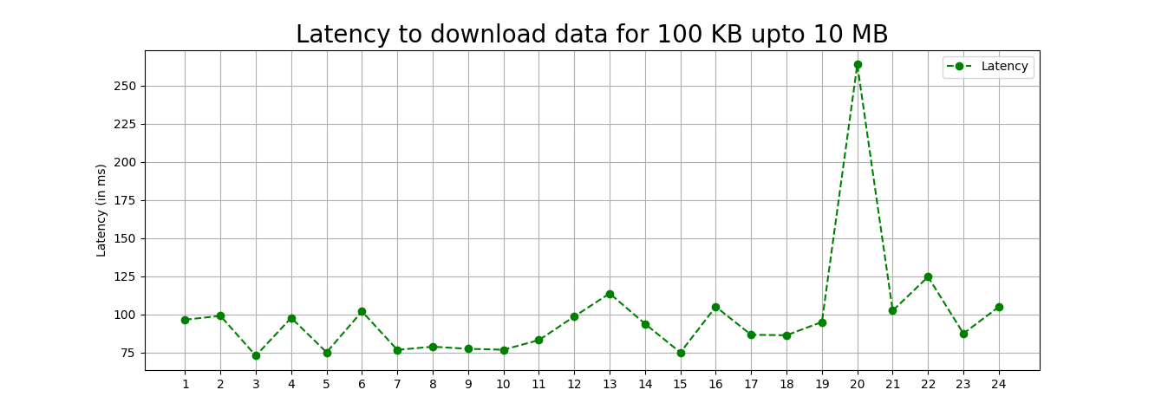
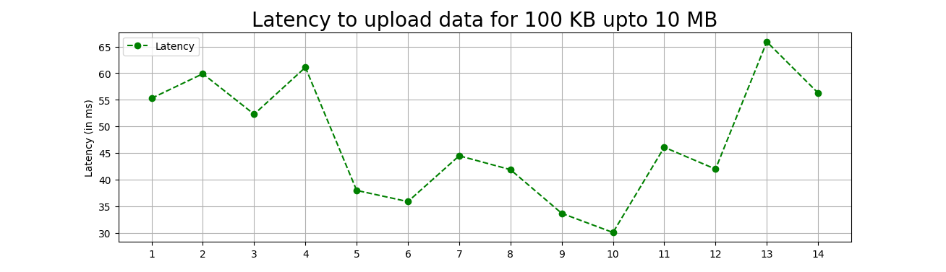
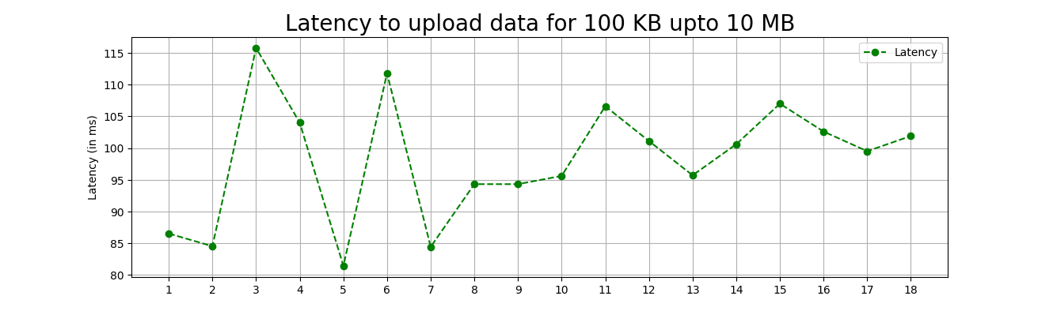
Field experiment
(a)(i) On the ground.
(a)(ii) At 108 feet elevation.
(b)(i) On the ground.
(b)(ii) At 108 feet elevation.
Figure: Internet speed on the ground and at 108 feet elevation.

Slide 34
Field experiment
Table: Latency in different types of streaming protocols and using RFB Protocol.
Protocol Name | Latency
WebRTC (Web Real-Time Communication) protocol used by google meet | 2 seconds
RTMPS which is a secure form of RTMP (Real Time Messaging Protocol) used by facebook live | 5-10 seconds
RTSP (Real Time Streaming Protocol) | 5-10 seconds
RFB (Remote FrameBuffer) Protocol | Less than 1 second

Slide 35
5
Discussion

Slide 36
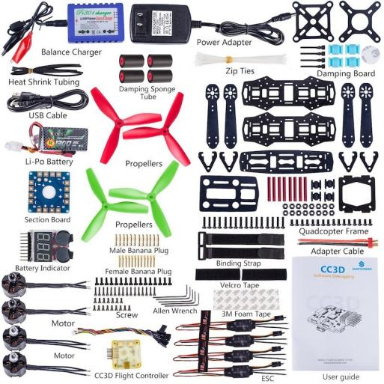
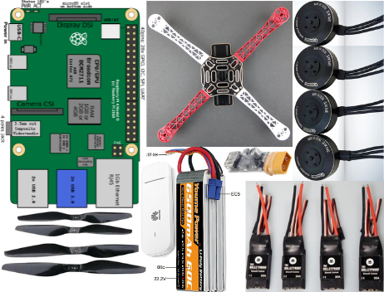
Discussion
(a) In traditional method.
(b) Using RFB Protocol.
Figure: Structure comparison.

Slide 37
Discussion
Table: Cost comparison of making a quadcopter drone between traditional method and using RFB protocol.
In traditional method | Cost | Using RFB protocol | Cost
F450 Frame (1 piece) | $17 | Same | $17
PDB (1 piece) | Already attached with the F450 Frame.
7s Flight Controller (1 piece) | $46 | Raspberry pi 4B 8GB (1 piece) | $87
Transmitter (1 piece) and Radio Receiver (1 piece) | $55 | HUAWEI E3372 LTE Modem(1 piece) | $32
7s ESC (4 pieces) | $37 x 2 = $74 | Same | $74
BLDC Motors (4 pieces) | $20 x 4 = $80 | Same | $80
6s Lipo Battery (1 piece) | $64 | Same | $64
FPV Camera (1 piece) and Video Transmitter (1 piece) | $19 | 5MP 1080P camera module for Raspberry pi 4B | $8
Video receiver Antenna(1 piece) | $32
Total | = $387 |  | = $362

Slide 38
5.1
Limitations

Slide 39
Limitations
The quadcopter that this thesis has created using RFB protocol is not a racing quadcopter.
This thesis is unable to reduce the time from getting the signal by the raspberry pi to response according to the user input. It is not because of the limitation of the cell towers or LTE modem. It is due to the limitation of the python threading and multiprocessing. After starting a thread it is needed to sleep the running code for a given time period otherwise, the running thread stops immediately. And if it is tried to use python multiprocessing technique, it is not permitted to pass a process as a parameter inside another process.
Another important fact about the quadcopter of this thesis is if some how connection lost than the system will wait for a given time period to get the user input. After this time period the system will automatically land just under the last position. It is not set to land in a safer place. Hope, later research will solve the problem.
Another limitation of this thesis is the internet speed testing which was tested at just 108 feet height. At this height the internet speed was slower than on the ground but the internet connection and it’s speed should be tested at higher altitude on a UAV that uses RFB protocol.
This type of UAV which uses RFB protocol will not work where there is no cell phone tower. Satellite internet works with this type of UAV but satellite internet is expensive. So, in these type of areas only WiFi will work well.

Slide 40
5.2
Contribution of this thesis

Slide 41
Contribution of this thesis
This thesis is able to reduce the complexity of a UAV structure by using a raspberry pi, a power source, ESCs and BLDC motors.
This thesis is able to live stream faster than the previous traditional live streaming protocols.
This thesis is able to reduce the cost of making a UAV.

Slide 42
6
Conclusion and future work

Slide 43
Conclusion and future work
In conclusion, it can be said that a user gets full satisfaction of controlling a UAV by using RFB protocol.
In one side, a user can control the UAV from anywhere in the world. On the other side, fast broadcasting enables the user to remotely control the UAV more efficiently.
Future works can be done on the following basis-
.(i) RFB protocol is little slow on raspberry pi as a server which has 32 bits processor. Latest 64 bits version has released. That should be checked out. Real VNC works well but more research should be done.
.(ii) Software researchers can work on python threading to stop a thread by writing stop command and on python multiprocessing to pass a process inside another process as a parameter.
.(iii) To control a UAV using RFB protocol a software can be build which will be installed in the server device so that a client can input command easily to move the UAV according to his/her need.

Slide 44
THANK YOU
Shakur Mahmood
ID: 22-92338-1
Department: MSCS
American International University - Bangladesh

